Slide 1

Introduction with online Apps

Slide 2
7 best Free video interviewing software platforms
1 Zoom
2 Microsoft teams
3 WhatsApp
4 Skype
5 Google meet
6 Team Viewer or Any Desk
7 Webex

Slide 3


How to use Zoom Apps
This Photo by Unknown Author is licensed under CC BY-SA

Slide 4
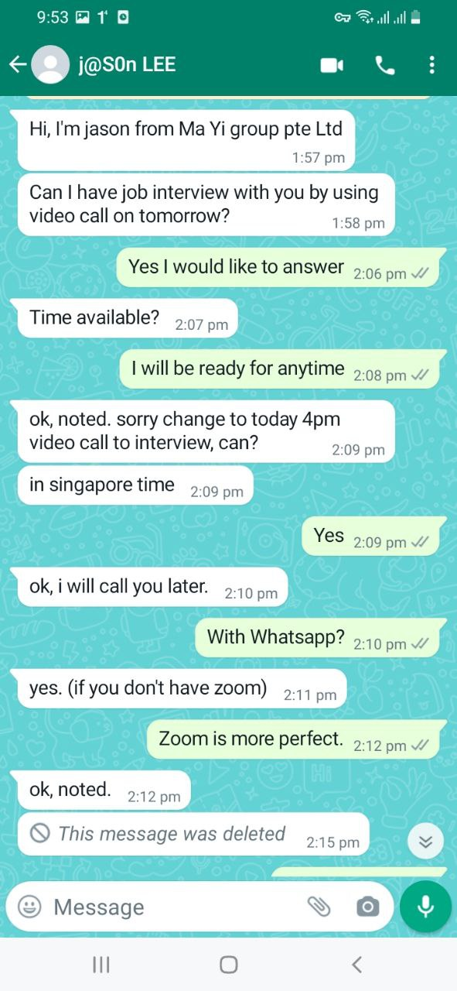
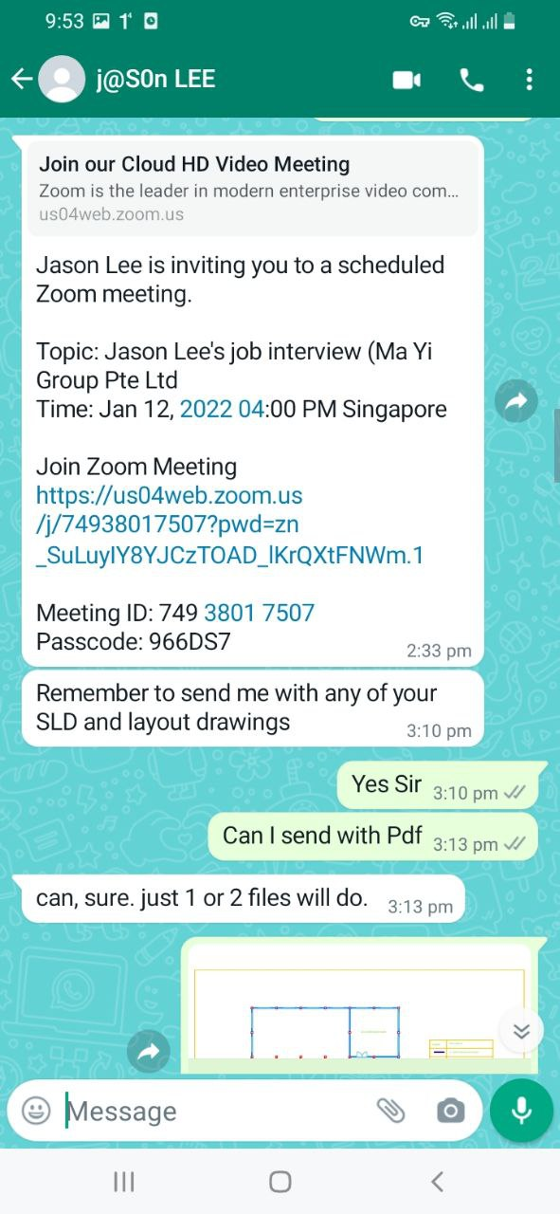
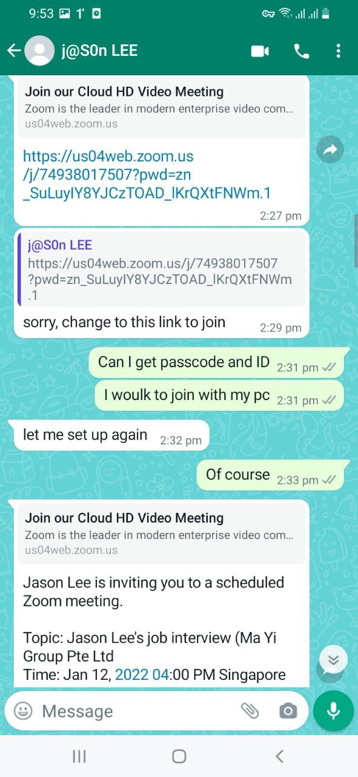

Slide 5
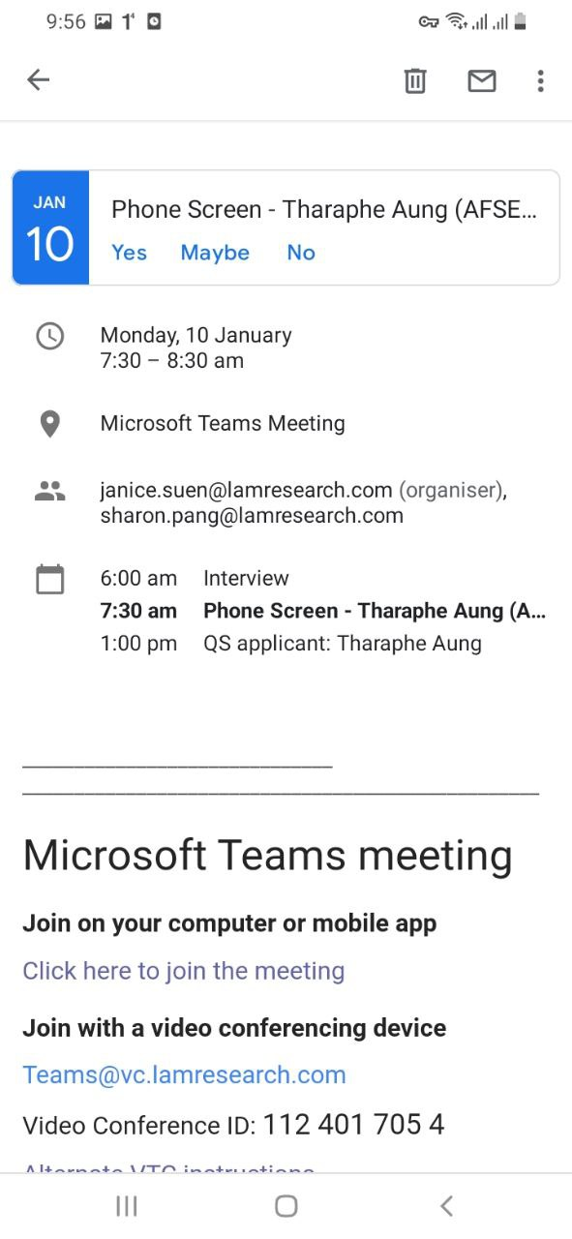
Microsoft Teams meeting
Join on your computer or mobile app
Click here to join the meeting
Join with a video conferencing device
Teams@vc.lamresearch.com
Video Conference ID: 112 401 705 4
Alternate VTC instructions
Or call in (audio only)
+65 3157 1917,,671775772# Singapore, Singapore
Phone Conference ID: 671 775 772#
Find a local number | Reset PIN
Learn More | Meeting options

Slide 6
Dear Lvy Lim
Thank you for your interview invitation.
I am delighted to answer the interview and I am ready for any time.
You may arrange online interview via Zoom or teams.
Best regards
Name
+959(WhatsApp)
Dear Madam,
It is a great honor to speak with you today about the service coordinator position today.
The job seems to be a perfect match for my ability and skill.
I appreciate the time you took for interviewing me. I believe I could learn a lot from your organization and work happily with you.
I look forward to hearing from you concerning with the hiring decision. And thank you again for your time and consideration.
Best regards,
Ei Thaw Tar Aung
+959975642323 (WhatsApp)

Slide 7
Dear Miss Tharaphe Aung,
Thank you for taking the time to do an online interview and discuss the job with our project engineer Mr Jason Lee on 12 Jan 2022.
We have completed all of our interviews and we are pleased to inform you that we would like to offer you the Electrical Engineer position.
As per our discussion, you agreed with the offered salary.
The next step is to apply for your work pass and could you be able to provide your reference?
Kindly provide your references such as personal information, travel document, educational certificates, and vaccination certificate (digitally-verifiable certificates) for work pass application purposes.
Please respond to this email to let us know if you would like to accept the electrical engineer position.
Should you have any questions or concerns, please do not hesitate to contact me.
Thank you.
Regards,
Poh Yee (Miss)
HR & Acct Assistant
MA YI GROUP PTE LTD
2 Yishun Industrial Street 1,
#06-13 Northpoint Bizhub,
Singapore 768159
Tel: 6635 2665

Slide 8
Dear Poh Yee(Miss)
Thank you for your job offer of Electrical Engineer at Ma Yi Group pte.ltd.
I am delighted to formally accept the offer, and I am very much looking forward to joining the team.
and I would like to send my certificates, vaccination certificates, and travel documents with attached files to you.
Best regards,
Tharaphe Aung

Slide 9
Dear Madam,
Following on from Monday's interview for the Assistant Field Service Engineer position, I wish to reaffirm my enthusiasm for the role and my desire to work for your organization.
I understand and appreciate you have lots of candidates to choose from, but if I am successful, I will be a committed, loyal and trustworthy member of your team who will consistently work hard to ensure you achieve your long-term business goals.
If you need any further information or documents from me, please do not hesitate to contact me.
Yours faithfully,
Miss THARAPHE AUNG
+959976821552(WhatsApp, Telegram)
Show quoted text

Slide 10

I wish all of you
Be getting a great job with High Salary Soon
This Photo by Unknown Author is licensed under CC BY-NC

